Slide 1

Introduction to Deep Learning
What is a
Neural Network?
deeplearning.ai

Slide 2
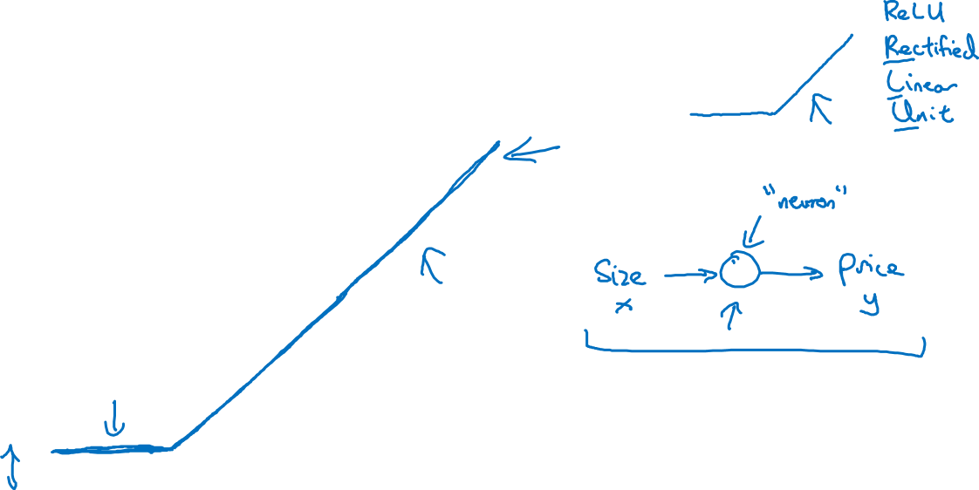
Housing Price Prediction
price
size of house

Slide 3
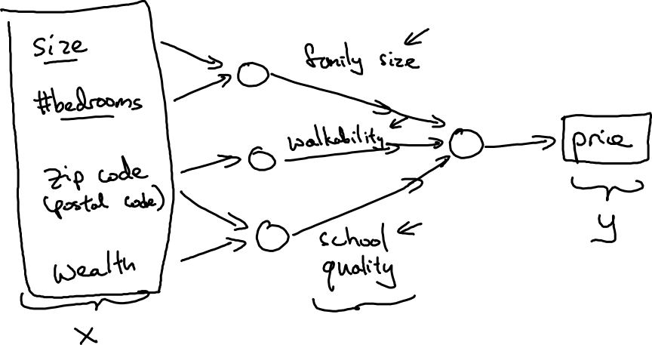
Housing Price Prediction

Slide 4

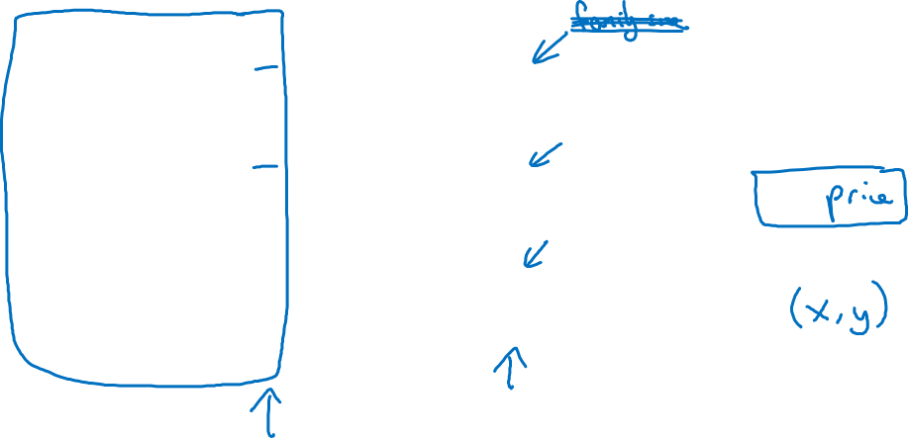




Housing Price Prediction
size
$$x_{1}$$
#bedrooms
$$x_{2}$$
y
zip code
$$x_{3}$$
wealth
$$x_{4}$$

